Slide 1
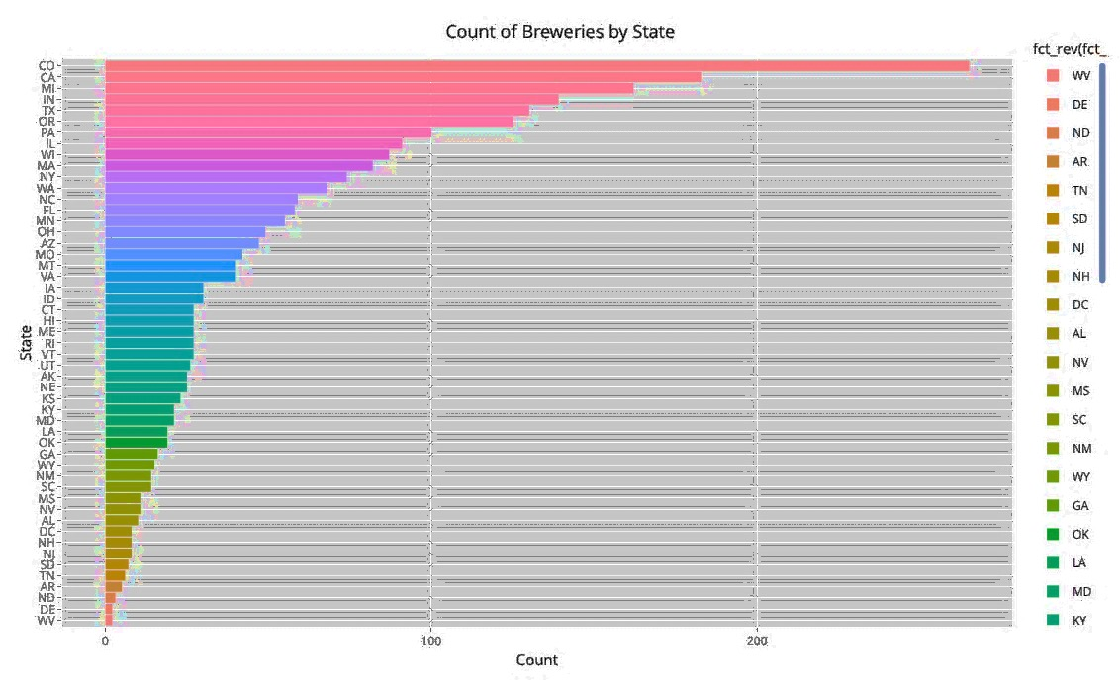
ATTRITION
PREDICTOR
Identification & Mitigation Analysis
Analytics
DDS
Project Team:
Heindel Adu
Ross Fu
Stephen Johnson
Anthony Yeung

Slide 2

Analysis Overview.
DDS Analytics, a data analytics and talent management company based in Dallas Texas, has been retained to review an employee data from a privately held corporation seeking to identify indicators of attrition in order to mitigate it.
Key steps employed are as follows:
Review dataset for suitability
Run Exploratory Data Analysis
Run an appropriate machine learning algorithm
Determine suitability of ML algorithm
Identify mitigating factors
DDS
ANALYTICS
Spring 2019

Slide 3

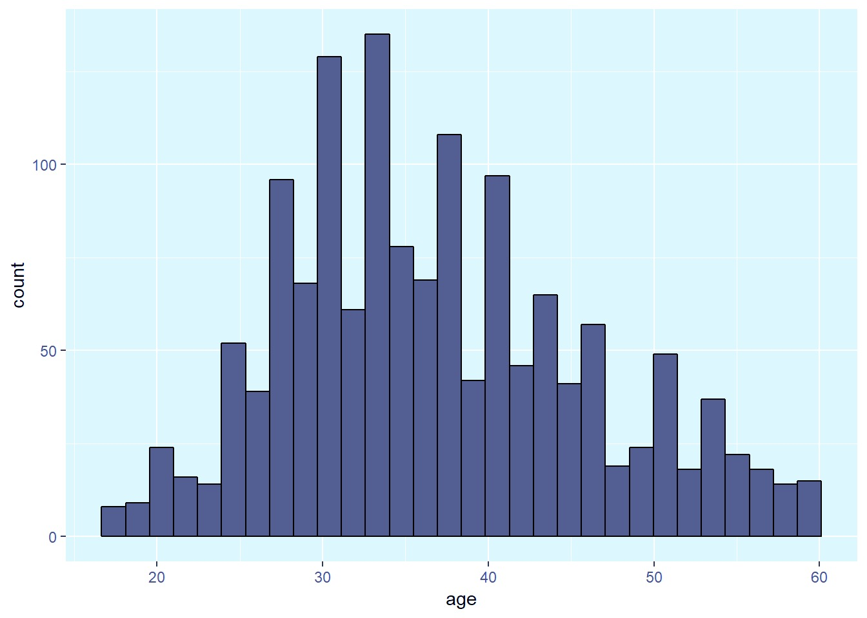
Age Distribution
STOCK
HOLDER

Slide 4
Summary Statistics
Age | Monthly Income | Education | Performance Rating | Job Satisfaction | Number of Companies Worked | Work Life Balance
Min. :18.00 | Min. : 1009 | Min. :1.000 | Min. :3.000 | Min. :1.000 | Min. :0.000 | Min. :1.000
1st Qu.:30.00 | 1st Qu.: 2911 | 1st Qu.:2.000 | 1st Qu.:3.000 | 1st Qu.:2.000 | 1st Qu.:1.000 | 1st Qu.:2.000
Median :36.00 | Median : 4919 | Median :3.000 | Median :3.000 | Median :3.000 | Median :2.000 | Median :3.000
Mean :36.92 | Mean : 6503 | Mean :2.913 | Mean :3.154 | Mean :2.729 | Mean :2.693 | Mean :2.761
3rd Qu.:43.00 | 3rd Qu.: 8379 | 3rd Qu.:4.000 | 3rd Qu.:3.000 | 3rd Qu.:4.000 | 3rd Qu.:4.000 | 3rd Qu.:3.000
Max. :60.00 | Max. :19999 | Max. :5.000 | Max. :4.000 | Max. :4.000 | Max. :9.000 | Max. :4.000

Slide 5
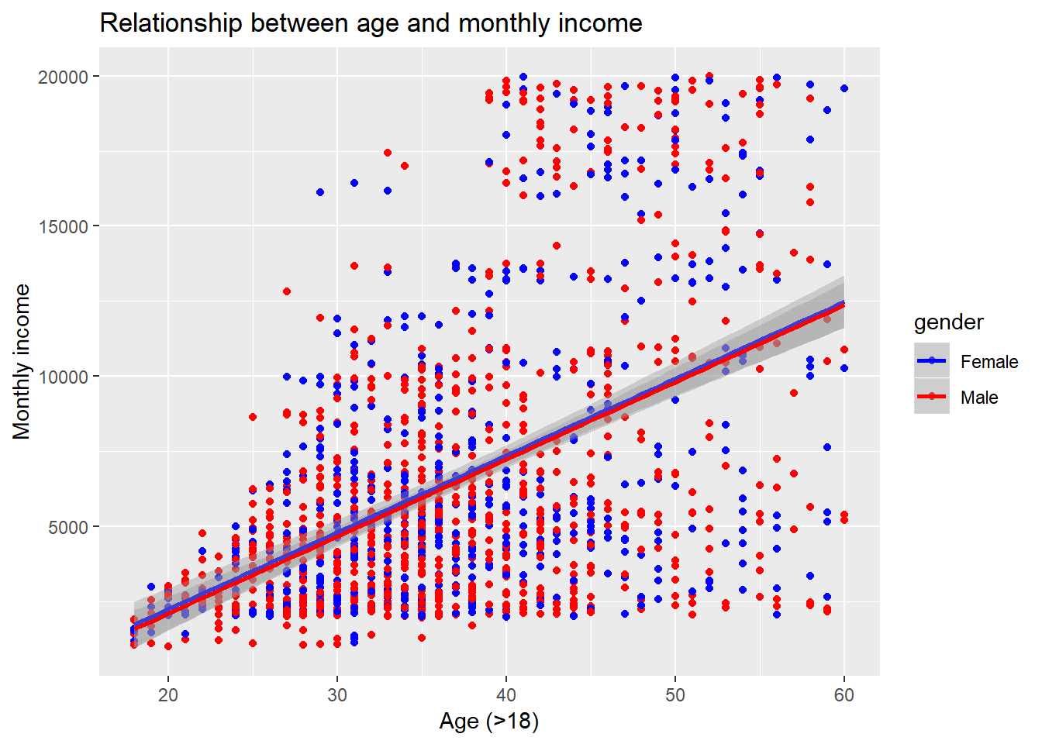
Count of Beer Brands per State
STOCK
HOLDER
50

Slide 6
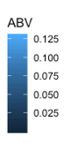
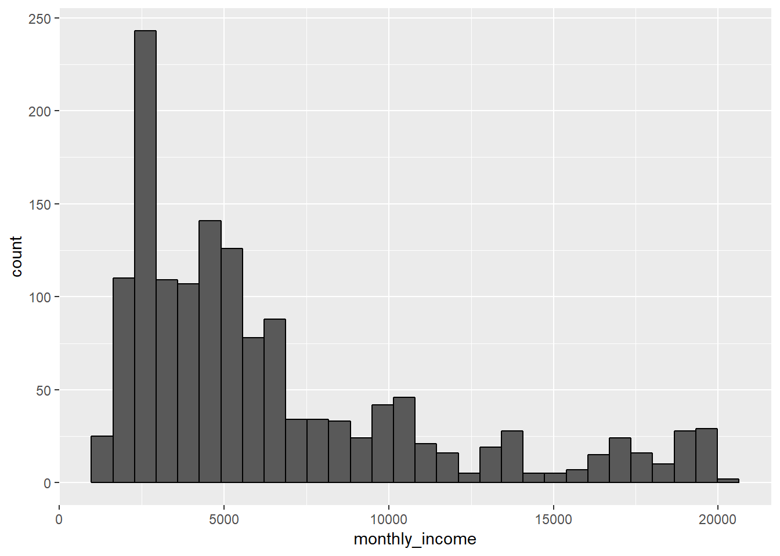
Income of Employees
STOCK
HOLDER
Daestrunt od qui que sectur as modi cumqui inus si bea non nus exeratio. Mil exerro erferum re corro omnient quam atiat.

Slide 7
Indicators of Life Satisfaction
 | Estimate | Std. Error | t value | Pr(>|t|)
(Intercept) | 8.2065175 | 0.2961577 | 27.709963 | 0.0000000
age | 0.0138749 | 0.0074587 | 1.860228 | 0.0630541
employee_number | -0.0001671 | 0.0000812 | -2.057894 | 0.0397774
genderMale | 0.1430717 | 0.0998467 | 1.432913 | 0.1520965
hourly_rate | -0.0063841 | 0.0024048 | -2.654759 | 0.0080227
over_timeYes | 0.3346806 | 0.1086668 | 3.079879 | 0.0021095
total_working_years | -0.0159800 | 0.0106838 | -1.495725 | 0.1349413
years_at_company | 0.0230156 | 0.0143622 | 1.602505 | 0.1092602
STOCK
HOLDER
Daestrunt od qui que sectur as modi cumqui inus si bea non nus exeratio. Mil exerro erferum re corro omnient quam atiat.

Slide 8
Gender, Education, Occupation
Gender
Female | 588
Male | 882
Education
1 | 170
2 | 282
3 | 572
4 | 398
5 | 48
Occupation
Healthcare Representative | 131
Human Resources | 52
Laboratory Technician | 259
Manager | 102
Manufacturing Director | 145
Research Director | 80
Research Scientist | 292
Sales Executive | 326
Sales Representative | 83
STOCK
HOLDER
Daestrunt od qui que sectur as modi cumqui inus si bea non nus exeratio. Mil exerro erferum re corro omnient quam atiat.

Slide 9
Machine Learning Models
Random Forest & Principal Component Ananlysis
STOCK
HOLDER
Daestrunt od qui que sectur as modi cumqui inus si bea non nus exeratio. Mil exerro erferum re corro omnient quam atiat.

Slide 10
ABV vs IBU per State
STOCK
HOLDER
Higher Concentration
Scatter plot of ABV vs IBU by state.
Colored by state.

Slide 11
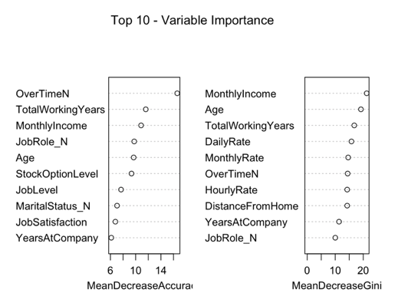
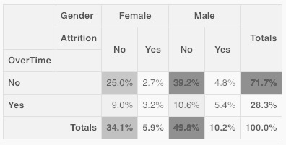
Random Forest Model Results
Performance & Insights
STOCK
HOLDER

Slide 12
Random Forest Model Results
Error Rate of RF Model
# of Nodes for the Tree
STOCK
HOLDER

Slide 13
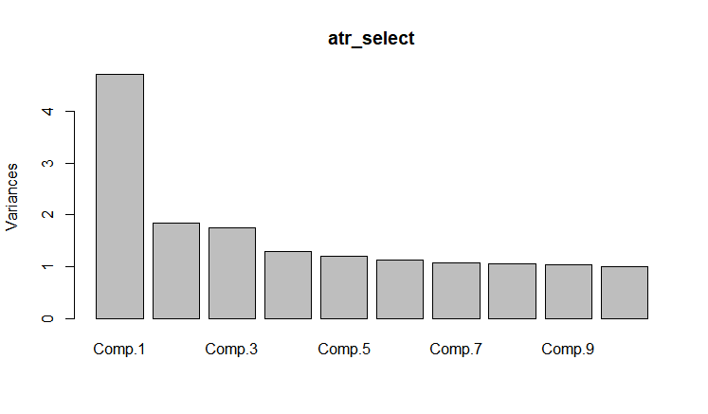
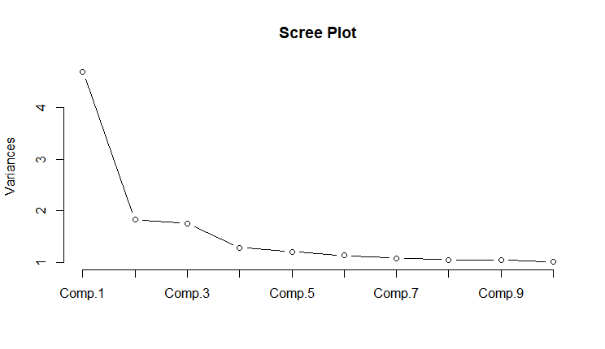
Principal Component Analysis
STOCK
HOLDER
Daestrunt od qui que sectur as modi cumqui inus si bea non nus exeratio. Mil exerro erferum re corro omnient quam atiat.

Slide 14
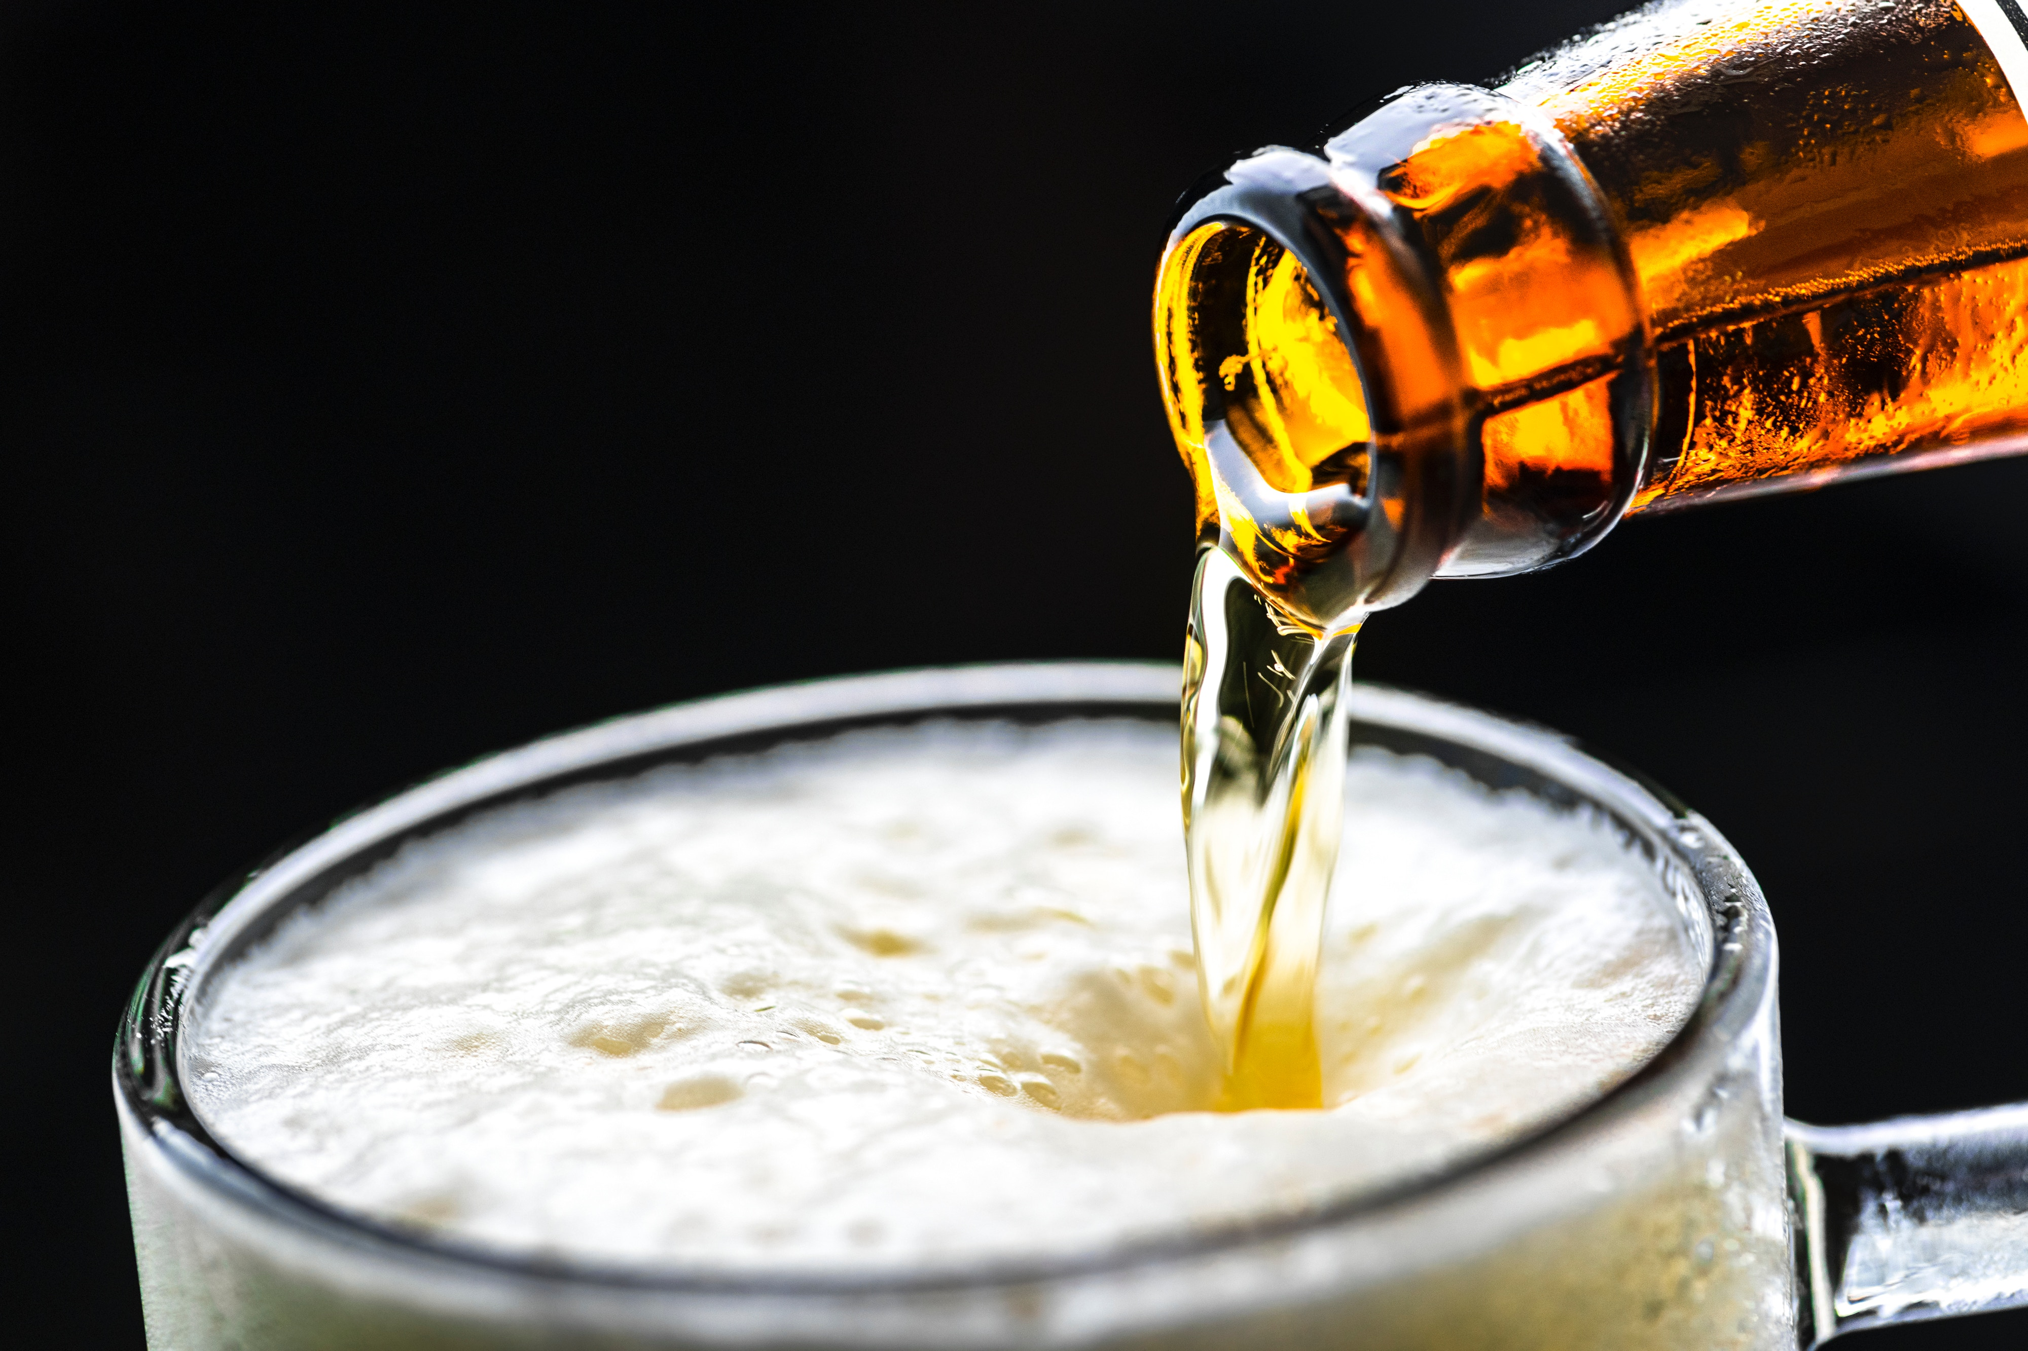
Alcohol By Volume:
Highest ABV (.128)
Upslope Brewing Co, Boulder Co
Lee Hill Series Vol 5
(Quadrupel)
Lowest ABV (.001)
Uncommon Brewers, Santa Cruz CA
Scotty K
(Low alcohol beer)
Highest IBU Value (138)
Astoria Brewing Co, Astoria OR
Bitter Bitch Imperial IPA
(American Double / Imperial IPA)
Lowest IBU Value (4)
Anderson Valley Brewing Co, Boonville CA
Summer Solstice (Cream Ale) 2009/2011
KEY
TAKE
AWAYS
International Bitterness Units:

Slide 15
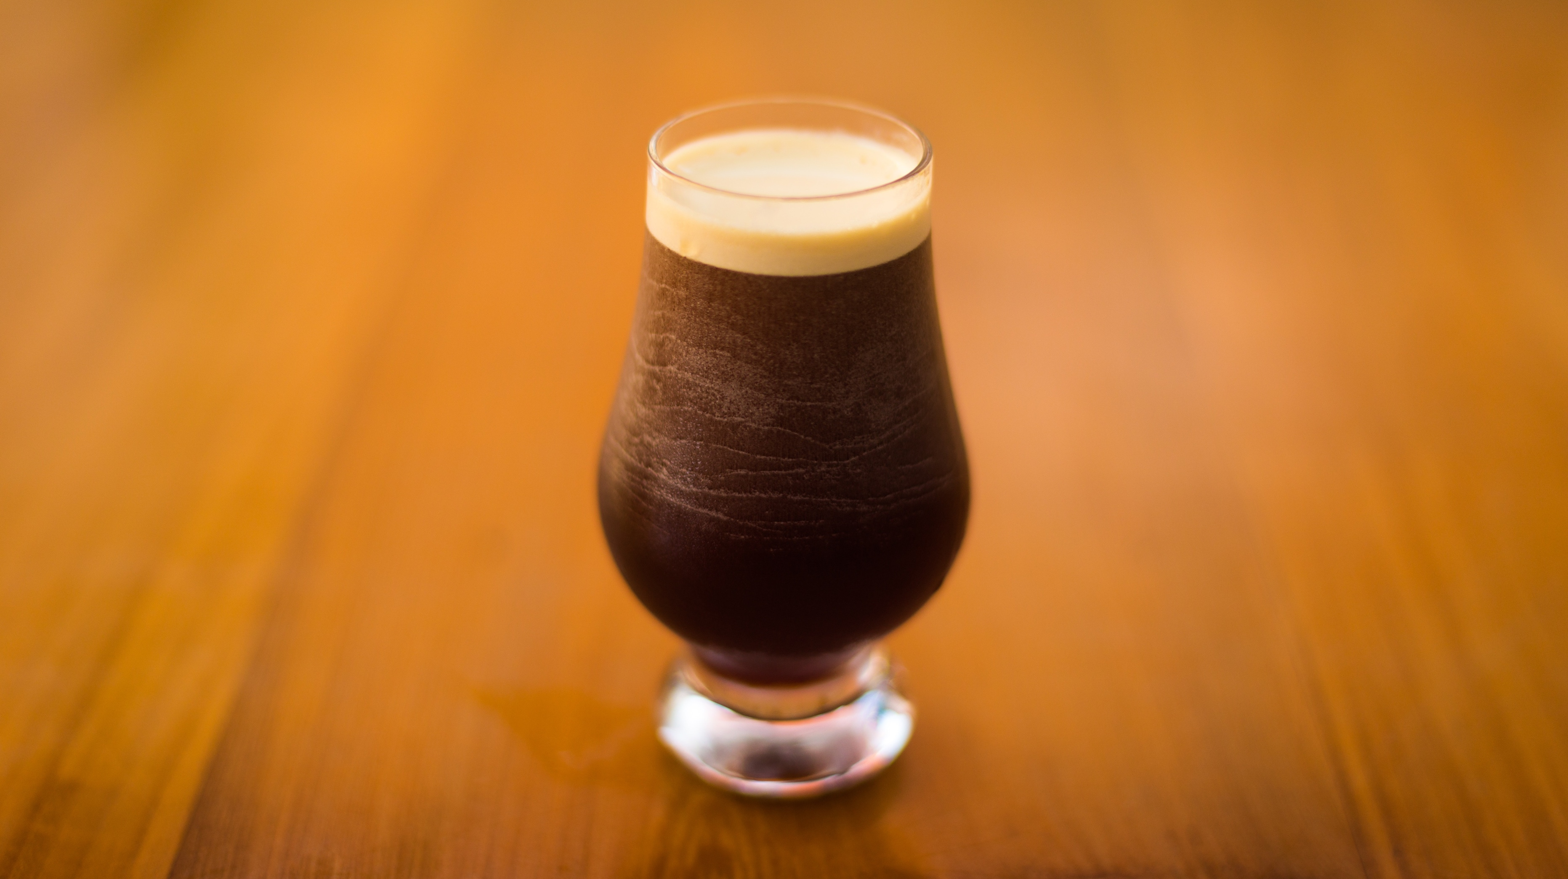
All other columns had no missing data
Highest IBU Value (138)
Astoria Brewing Co, Astoria OR
Bitter Bitch Imperial IPA
(American Double / Imperial IPA)
Lowest IBU Value (4)
Anderson Valley Brewing Co, Boonville CA
Summer Solstice (Cream Ale) 2009/2011
Column Missing Data Count
ABV | IBU | Beer Style
62 | 1,005 | 5
KEY TAKE-AWAYS
International Bitterness Units:
Daestrunt od qui que sectur as modi cumqui inus si bea non nus exeratio. Mil ortodova exerro erferum realer socorro omnient quam

Slide 16
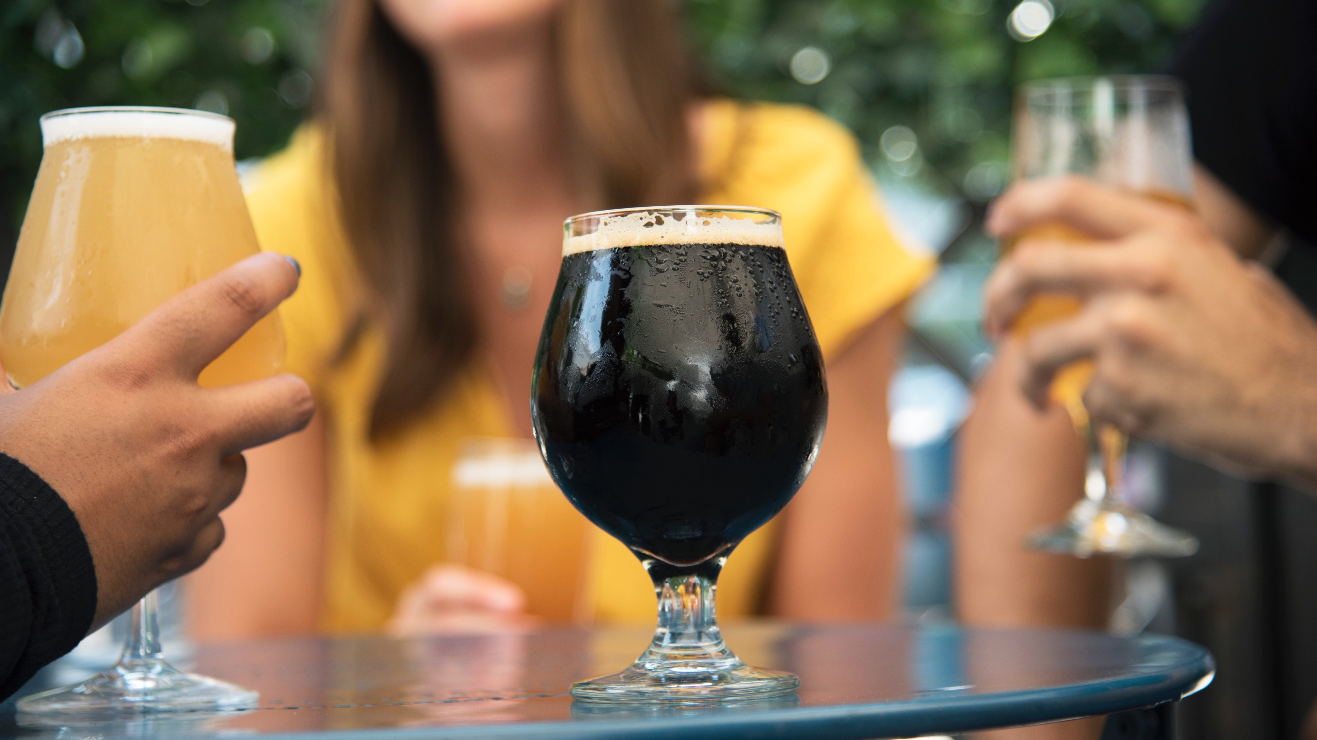
Marketing Channels Data:
Greater insights into craft beer consumer behavior
Sales Volumes
Craft Beer Pricing Data
Raw-material Sourcing Data
Regulatory Atmosphere For Craft Beer
NEXT
STEPS

Slide 17
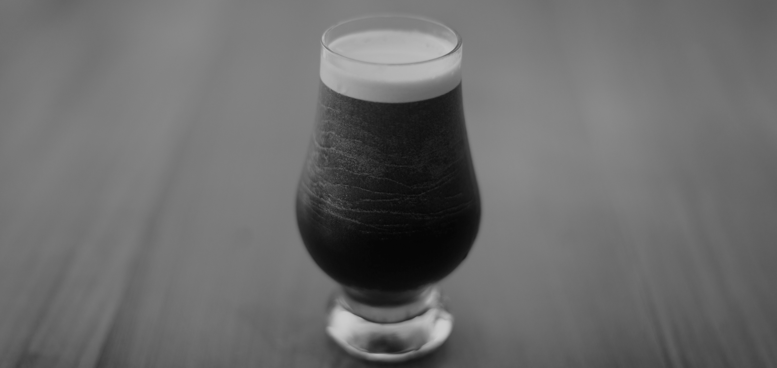
QUESTIONS ?
THANKS
AGH DATA CONSULT INC.
DALLAS, TX

Slide 18
AGH DATA CONSULT INC.
P | 03
AGH
DATA CONSULT Inc.
Data like never Before.
We are a Data Science Group dedicated to helping our clients make sense from their data.

